Slide 1
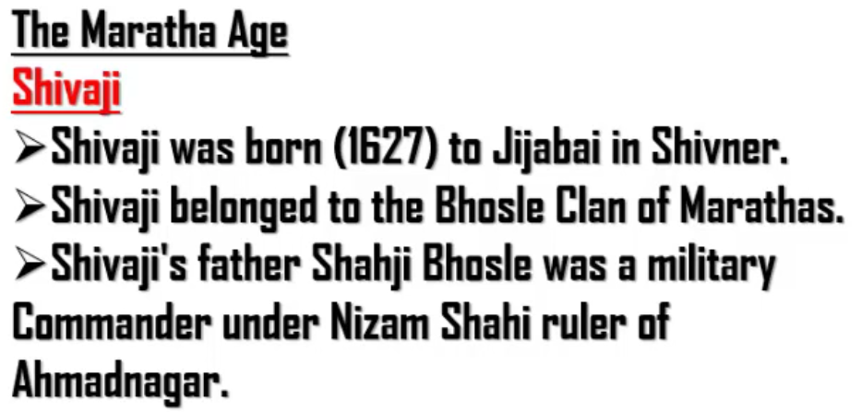
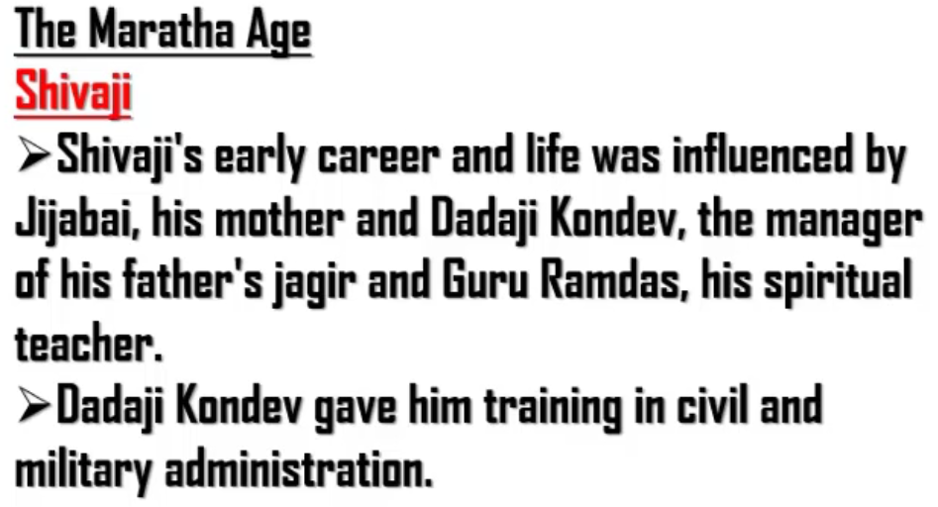

Slide 2
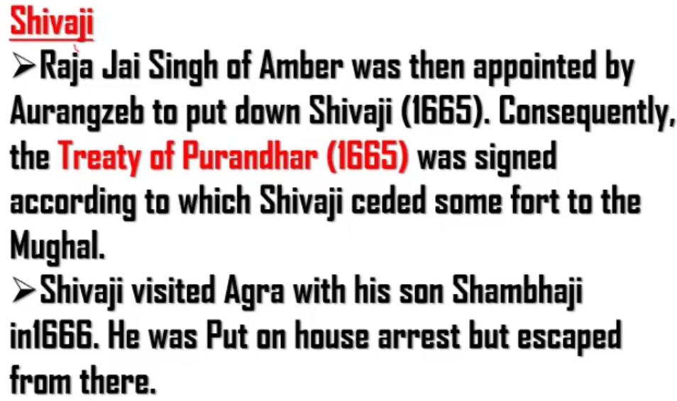
Shivaji started growing up equivalent to Aurangzeb. So he wanted to crush Shivaji.
So, Aurangzeb appointed some one called Raja Jai Singh under his control to crush Shivaji.
Accordingly, Raja Jai Singh fought a war against Shivaji and won. As Shivaji lost the war, he was made to sign the treaty “Treaty of Purandhar” in 1665.
According to this treaty, Shivaji had to surrender some of his forts to Mughal.

Slide 3
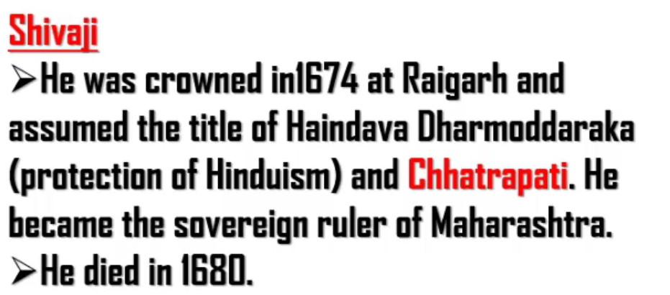

Slide 4
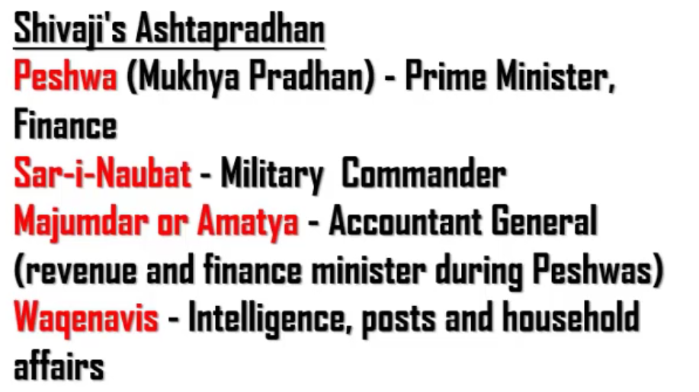
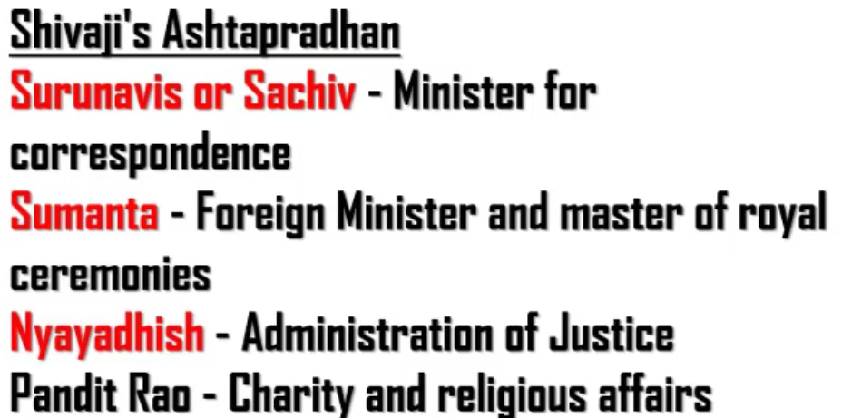
Minister of Correspondence – Minister of State for corresponding department

